Slide 1


SMART INDIA HACKATHON 2024
Problem Statement ID: SIH1550
Problem Statement Title: Development of Portable Device (Non-Contact) for Measurement of Eye Pressure in Glaucoma Patients for Usage at Home
Theme: MedTech/BioTech/HealthTech
PS Category: Hardware
Team ID:
Team Name: Visionaries

Slide 2
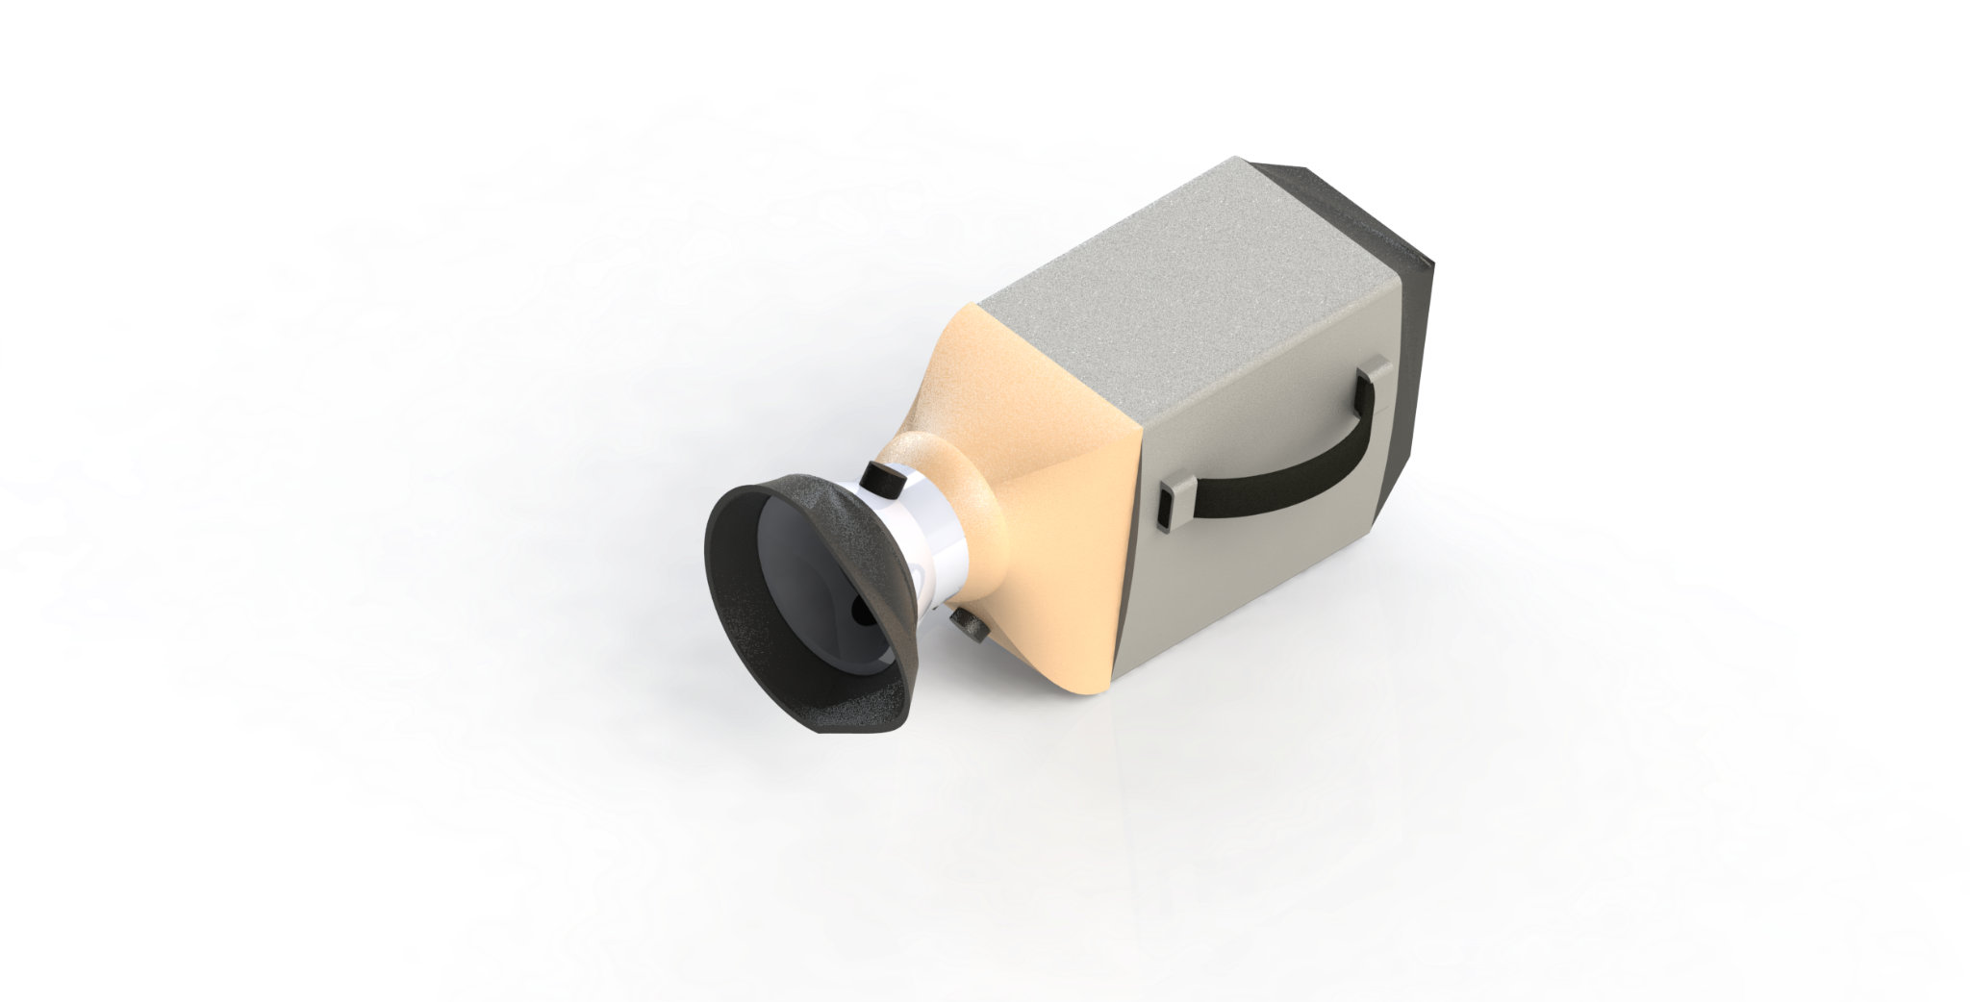
BRIEF OVERVIEW
Visionaries
Solution:
Ultrasonic Tonometer technology to measure the Intraocular Pressure of the eye​.
Microcontroller (Arduino Uno) is used to process the modulation of the wave reflected from eye​ to get Intraocular Pressure(IOP).
​
How it addresses the problem​
Easy and accessible
Non-contact tonometry prevents infections and discomfort​.
Innovation of the solution ​
Modified ultrasound acoustic Tonometry to avoid eye irritation​
Highly cost efficient compared to the existing solutions​.

Slide 3
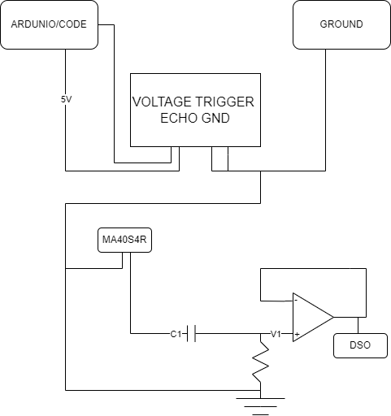
TECHNICAL APPROACH
Visionaries
Technologies used
Programming Languages: Embedded C​
Hardware:​ T04 transmitter, Arduino, LCD- 16x2, MAS04R Receiver​​, Speaker.
Methodology and Process of
Implementation
TRIGGER
ECHO
VCC
GND
Design
Electronics assembly
Shell assembly
Testing
Calibration
CIRCUIT DIAGRAM

Slide 4
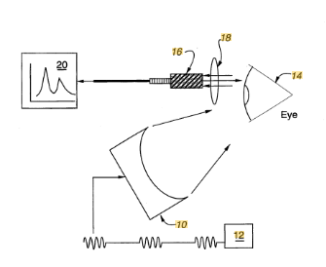
FEASIBILITY AND VIABILITY
Visionaries
Analysis of the feasibility of the idea​
Ultrasound Tonometry is an emerging technology which is yet to reach its full potential.
Feasibility study:https://jsss.copernicus.org/articles/7/123/2018/
Potential challenges and risks​
Background/ Research data not vast enough to improve accuracy as it’s new.​
Manual alignment to eye may not always be reliable​.
Strategies for overcoming these challenges​
Auto-align to improve design and accuracy of the tonometer​.
Enough database is available to make sure the concept works​.

Slide 5
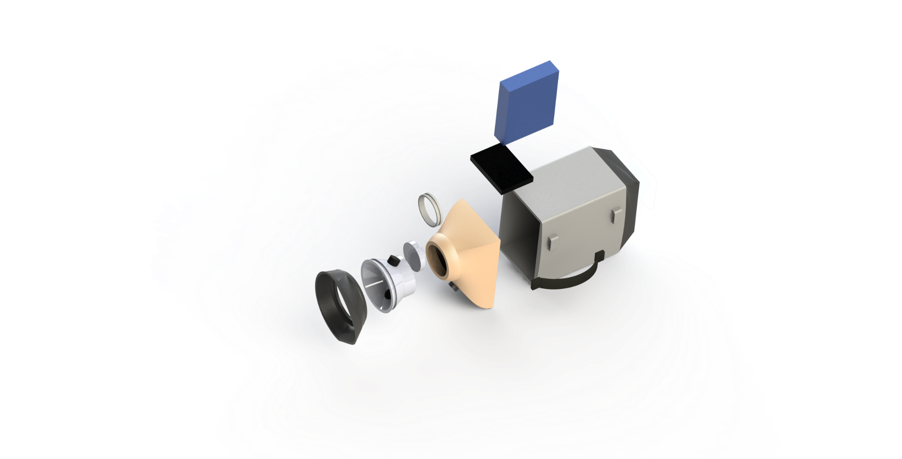
Visionaries
IMPACT
BENEFITS
Efficient and easier workflow for doctors
People at risk can be easily identified and appropriate care can be taken​.
Long-term investment with no disposable parts​.
Non-invasive and causes minimal discomfort
More than 75% of 12 million people having glaucoma are not diagnosed
Increase the diagnosis rate and reduce glaucoma-induced blindness.

Slide 6
BIBLIOGRAPHICAL REFERENCES
Visionaries
Dependence Of Iop Of Glaucoma
https://youtu.be/7u_DzBNeC98?si=fSz9Y9E9R7taL_Xf​
How Ultrasonic Works
https://youtu.be/I1Bdp2tMFsY?si=_MP8h7LZeaAsQBGw​
Effect Of Iop On Biometric Parameters
https://jsss.copernicus.org/articles/7/123/2018/​
Acoustic Tonometry Model
https://designday.jhu.edu/design-day-projects/entry/10133/​
Relation Between Iop And Soundwaves
https://patents.google.com/patent/US4928697A/en

Slide 7
IMPORTANT INSTRUCTIONS
Please ensure below pointers are met while submitting the Idea PPT:
Kindly keep the maximum slides limit up to six (6). ( Including the title slide)
Try to avoid paragraphs and post your idea in points /diagrams / Infographics /pictures
Keep your explanation precise and easy to understand
Idea should be unique and novel.
You can only use provided template for making the PPT without changing the idea details pointers (mentioned in previous slides).
You need to save the file in PDF and upload the same on portal. No PPT, Word Doc or any other format will be supported.
Note - You can delete this slide (Important Pointers) when you upload the details of your idea on SIH portal.

Slide 8
APPENDIX
Visionaries
Visionaries
Existing Solutions
Electronic Components
Calculations
Theory
Cost analysis
Battery Life Calculation

Slide 9
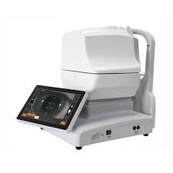
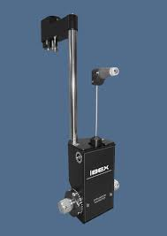
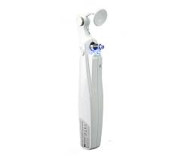
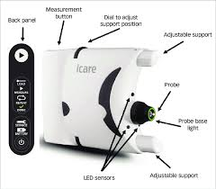
APPENDIX
Visionaries
Visionaries
Existing Solutions
Technology:
NCT Air Puff tonometer
GAT Contact Tonometer
Perkins Tonometer
Rebound Tonometer

Slide 10
APPENDIX
Visionaries
Visionaries
Electronic Components:
Arduino Uno
LCD 16 X 2
Op-Amp
MA40S4R Receiver
T40 Transmitter(HC SR-04)
Speaker

Slide 11
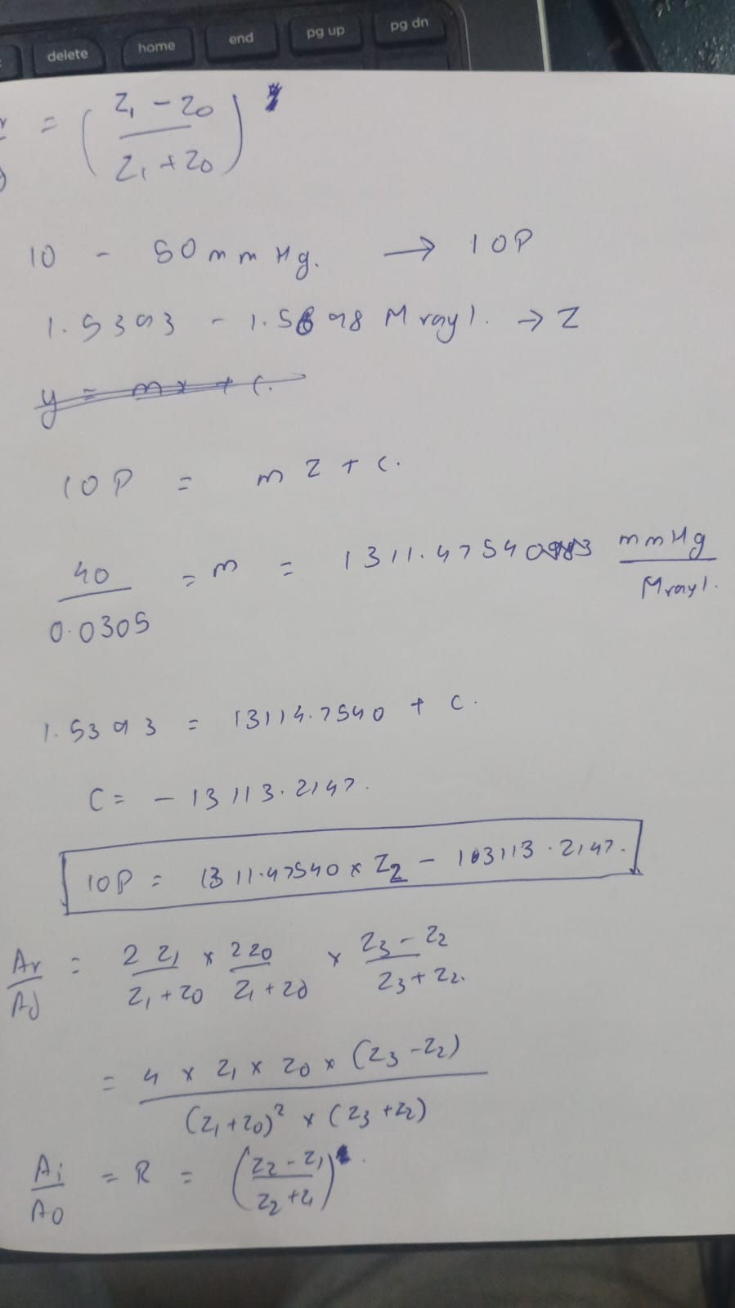
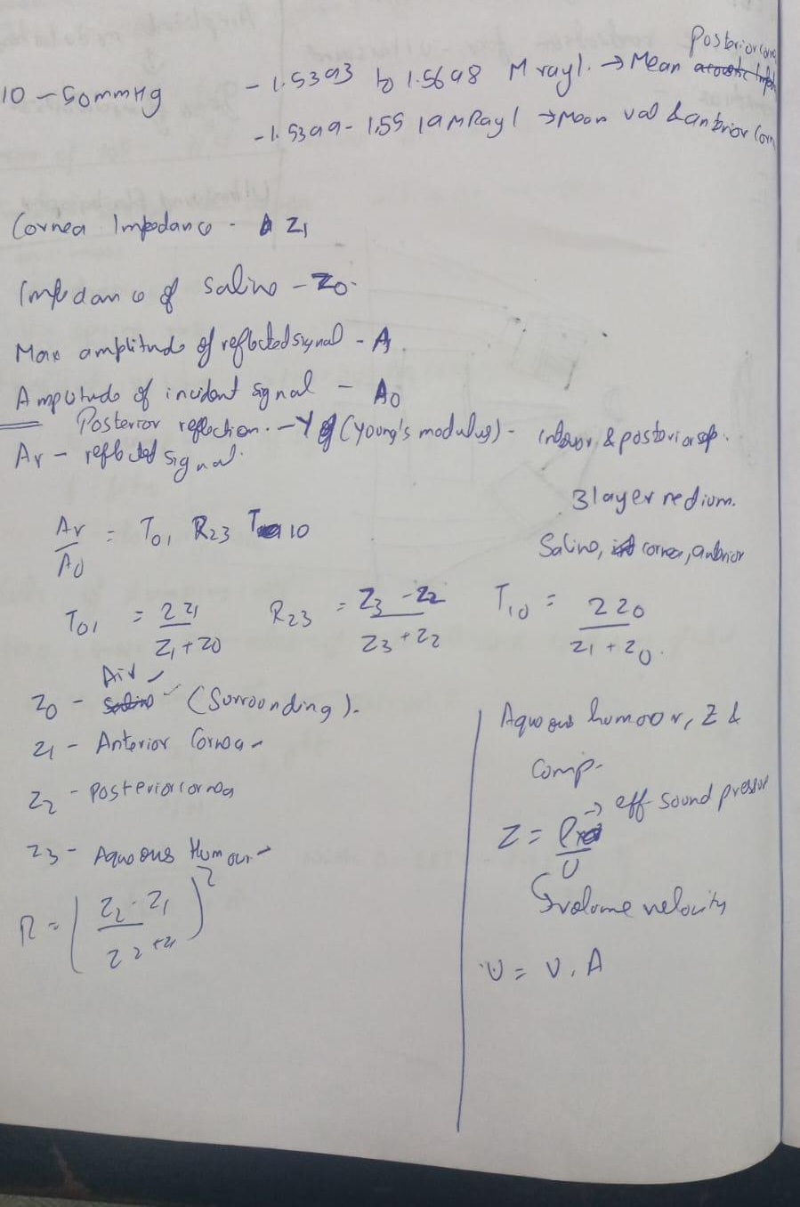
APPENDIX
Visionaries
Visionaries
Calculations

Slide 12
APPENDIX
Visionaries
Visionaries
Theory:
Acoustic impedance is the product of the density and speed of sound in the tissue.
When sound waves bounce off of eye, some of the wave is absorbed by eye and the rest is reflected back.
This ratio is used to find the acoustic impedance of eye.
Acoustic impedance of eye is linearly correlated to the IOP.

Slide 13
APPENDIX
Visionaries
Visionaries
Cost Analysis
Arduino UNO 250
Speaker 45
Transmitter (from HC SR-04) 130
Receiver( MA40S4R) 1750
Resistors 5
Capacitors 15
LM358(if needed) 40
LCD 200
Batteries 700
Total:3135

Slide 14
APPENDIX
Visionaries
Visionaries
Cost Analysis
BATTERY AND VOLTAGE CALCULATIONS
Voltage ratings:
Transmitter(T04) : 5V
Receiver (MA40S4R) : 5.5V
Op Amp (LM358) : 5V
LCD : 3.3V
Arduino : 5V
Power Consumption:
Transmitter(T04) : 100mW
Receiver (MA40S4R) : 100mW
Op Amp (LM358) : 10mW
LCD : 10mW
Arduino : 100mW
Battery Life = Battery Capacity (mAh)/Max current drawn
Approx 4.7 Hours battery life

